Slide 1
Laura Sheneman August 17, 2020
Through the Lens of SAMR

Slide 2
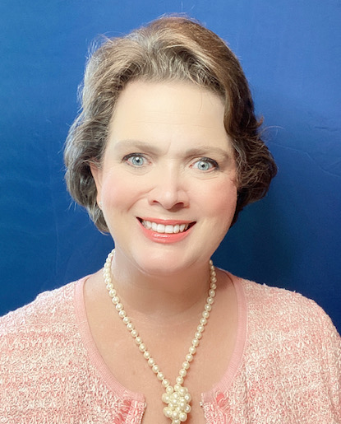
Laura Sheneman, EdD & MLS

Slide 3
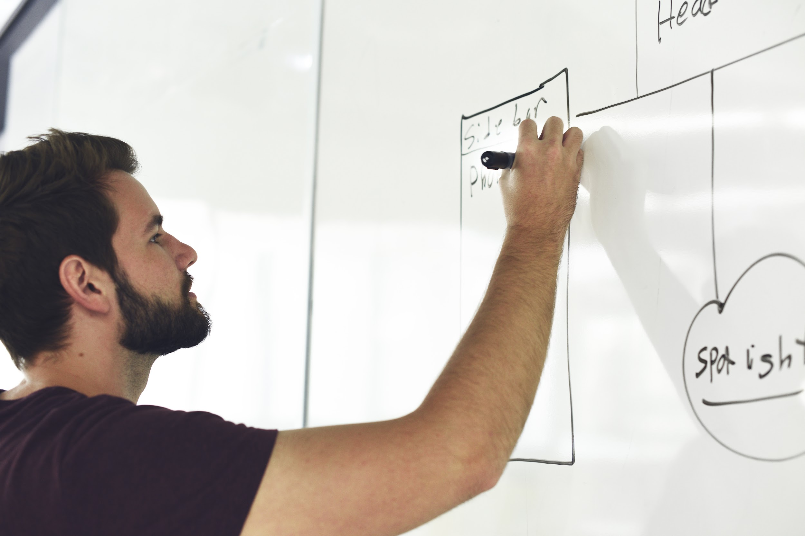
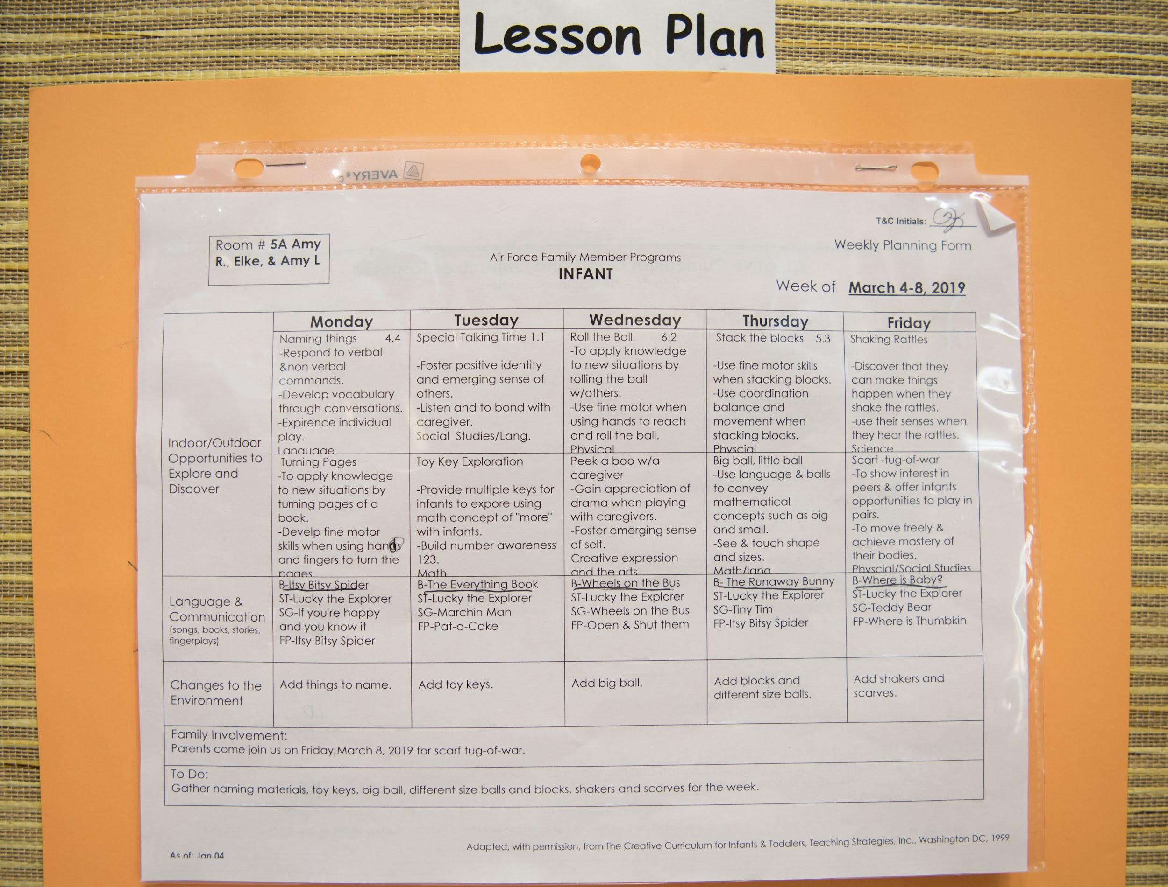
Your Life as an
Educator

Slide 4
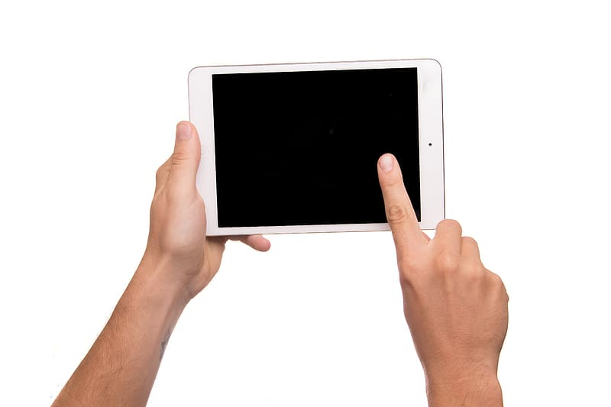
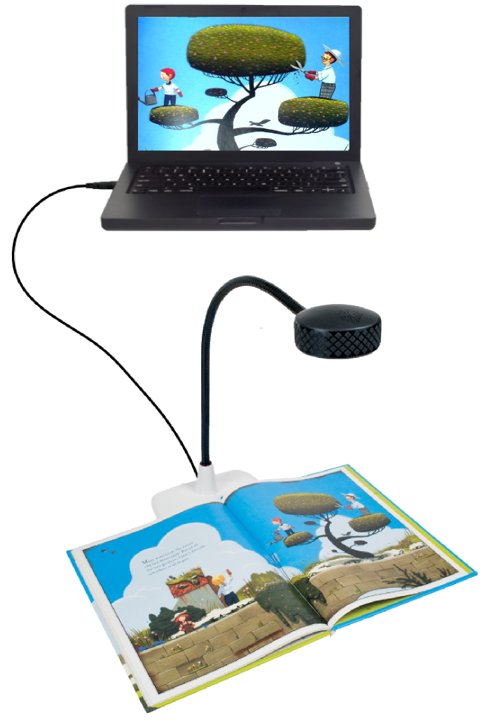
Your Life as an
Educator 2.0
Notes:
21st century learning skills
Individualized instruction
Personalized learning
And more recently remote learning

Slide 5
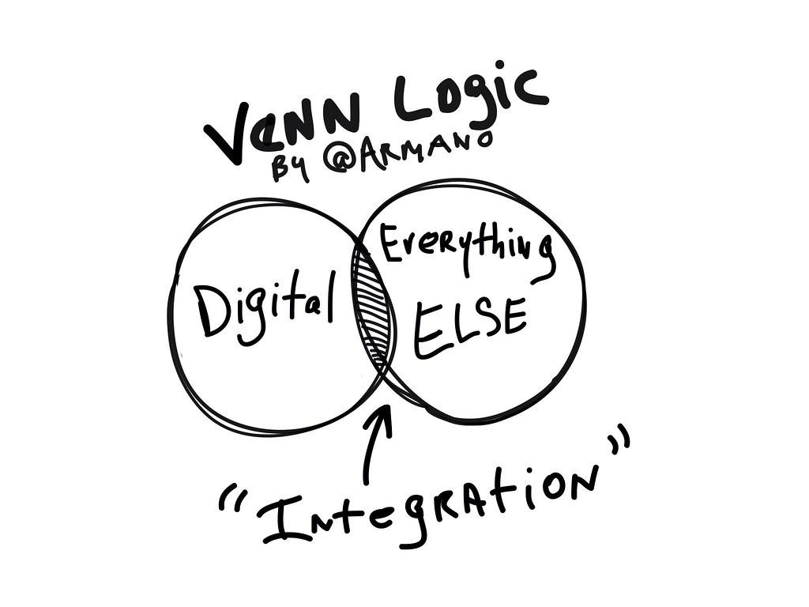

Slide 6
Laura Sheneman August 17, 2020
Through the Lens of SAMR

Slide 7
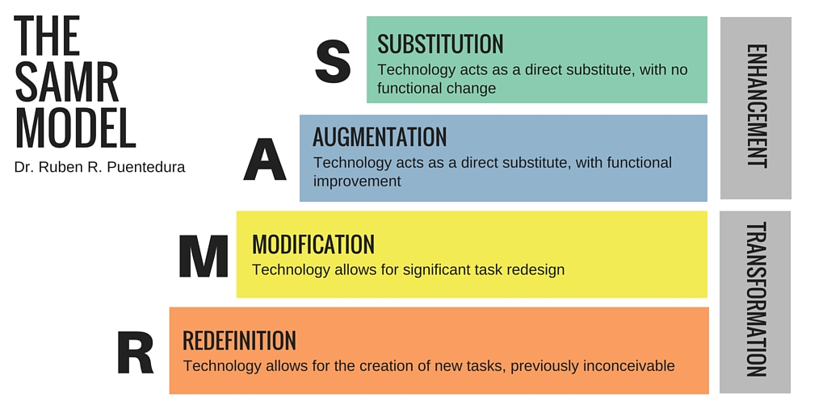
A Model for Understanding Powerful Tech Integration
https://commons.wikimedia.org/wiki/File:The_SAMR_Model.jpg Creative Commons Attribution-Share Alike 4.0 International license
Notes:
What types of technology use would have greater or lesser effects on student learning.

Slide 8
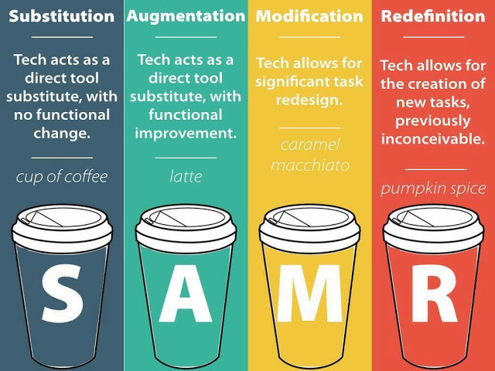
By Jonathan Brubaker http://techtipsedu.blogspot.com/2013/11/samr-model-metaphor-mistakes.html

Slide 9
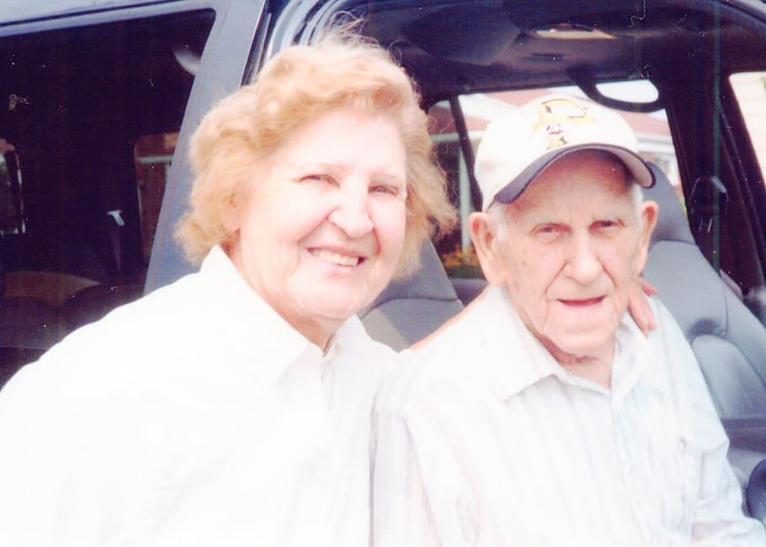
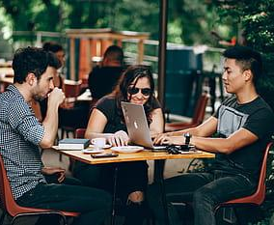
By Jonathan Brubaker http://techtipsedu.blogspot.com/2013/11/samr-model-metaphor-mistakes.html

Slide 10
What is this really all about?

Slide 11
What is this really about?
It’s NOT about giving teachers and students technology.

Slide 12
It’s about transforming teaching and learning!

Slide 14
A Model for Understanding Powerful Tech Integration
https://commons.wikimedia.org/wiki/File:The_SAMR_Model.jpg Creative Commons Attribution-Share Alike 4.0 International license
Notes:
What types of technology use would have greater or lesser effects on student learning.

Slide 15
The technology used is a direct substitute of something previously used.
Ex. The teacher reads an eBook to the students rather than using a printed book.
ENHANCEMENT
S
Substitution
Notes:
And because of how are classrooms are now, they could be projecting on to a whiteboard, sharing their screen with students at home, using a computer lab at school or any other number of scenarios.
And they choose to read to them by using screenshare where the teacher is sharing their computer screen that has the Lightbox eBook playing.
At this level, there is no interaction with the book. It is simply reading the book.

Slide 16
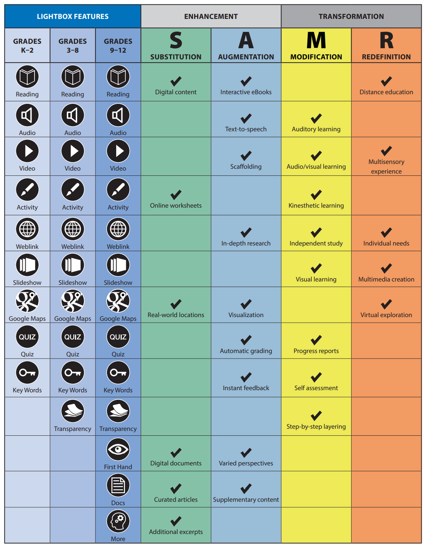
Notes:
Replace hard copy source materials with digital documents, firsthand accounts, maps, and more. Enable students to complete and submit worksheets, tests, and activities online or by email.

Slide 17
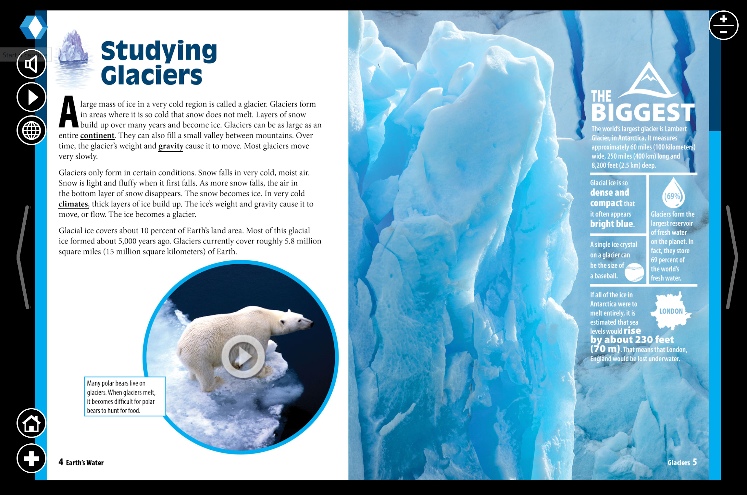

Slide 18
ENHANCEMENT
S
Substitute an eBook for a printed book.
Augmentation - Technology is still a direct substitute for the tool but now you take advantage of the special features available.
Ex. Instead of simply reading to the students, the teacher guides the students to take advantage of the interactive features of the text.
The teacher links the eBook (functional improvement) in the LMS and the students can read it themselves whenever they want.
A
Augmentation
Notes:
They hear it read aloud if they need reading support. They play the videos to build deeper learning. They interact with Google Maps and other interactive features.

Slide 19
Notes:
Create presentations, videos, artwork, and other projects using digital Lightbox resources that make it easy to tailor the learning experience to individual interests and needs. Provide varying perspectives and points of view on specific issues or events for a deeper interaction between educators, students, and their peers. Maintain contact with learners even when teaching remotely.

Slide 21
ENHANCEMENT
S
Substitute an eBook for a printed book.
A
Augmentation - take advantage of the special features.
Modification - the task is significantly redesigned by the introduction of technology.
Ex. The teacher does not simply use the eBook as a story. But instead he is able to tailor student’s learning to their interests and needs.
TRANSFORMATION
M
Modification
Notes:
He lets students uses Lightbox to create presentations and work on PBL.
Create presentations, videos, artwork, and other projects using digital Lightbox resources that make it easy to tailor the learning experience to individual interests and needs. Provide varying perspectives and points of view on specific issues or events for a deeper interaction between educators, students, and their peers. Maintain contact with learners even when teaching remotely.

Slide 22
Notes:
Create presentations, videos, artwork, and other projects using digital Lightbox resources that make it easy to tailor the learning experience to individual interests and needs. Provide varying perspectives and points of view on specific issues or events for a deeper interaction between educators, students, and their peers. Maintain contact with learners even when teaching remotely.

Slide 23
ENHANCEMENT
S
Substitute an eBook for a printed book.
A
Augmentation - take advantage of the special features.
M
Modification - the task is modified.
TRANSFORMATION
Redefinition - New tasks are possible that were never possible before.
Ex. The teacher can use Lightbox for distance education or flipped learning opportunities.
The teacher posts a link to the eBook and asks the students to add to the class book being created in the BookCreator app.
R
R
Notes:
The teacher allows students to accelerate their learning by pursuing topics of interest to them.
Provide a multi-sensory experience that goes beyond traditional classroom teaching and engages different learning styles while still covering the same core material. Give students the opportunity to accelerate their learning if they are ready for more advanced materials. Explore a variety of subject areas through virtual visits to historic sites, museums, science centers, and other facilities while using the Google Maps feature to gain further insight into specific locations. Provide a launching pad for the creation of multimedia projects, ranging from the creation of videos/short films to multimedia art installations, on a variety of subjects.

Slide 24
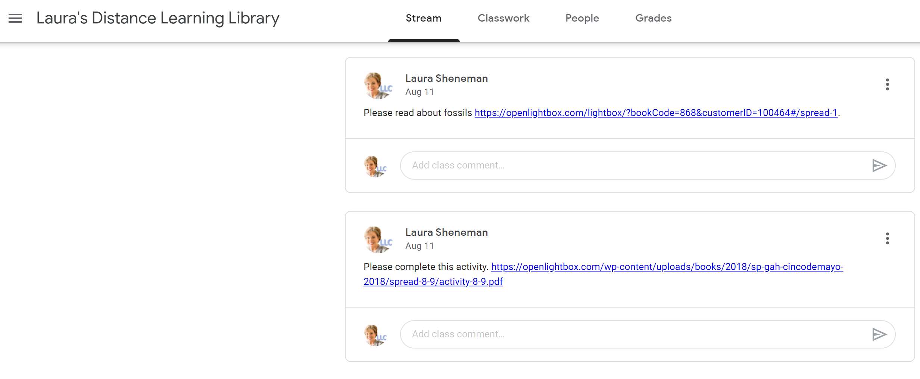

Slide 25
Notes:
Provide a multi-sensory experience that goes beyond traditional classroom teaching and engages different learning styles while still covering the same core material. Give students the opportunity to accelerate their learning if they are ready for more advanced materials. Explore a variety of subject areas through virtual visits to historic sites, museums, science centers, and other facilities while using the Google Maps feature to gain further insight into specific locations. Provide a launching pad for the creation of multimedia projects, ranging from the creation of videos/short films to multimedia art installations, on a variety of subjects.

Slide 26
Curriculum Standards
National Generation Science Standards (NGSS)
National Council for the Social Studies (NCSS)
Common Core State Standards (CCSS)
Other State Standards

Slide 27
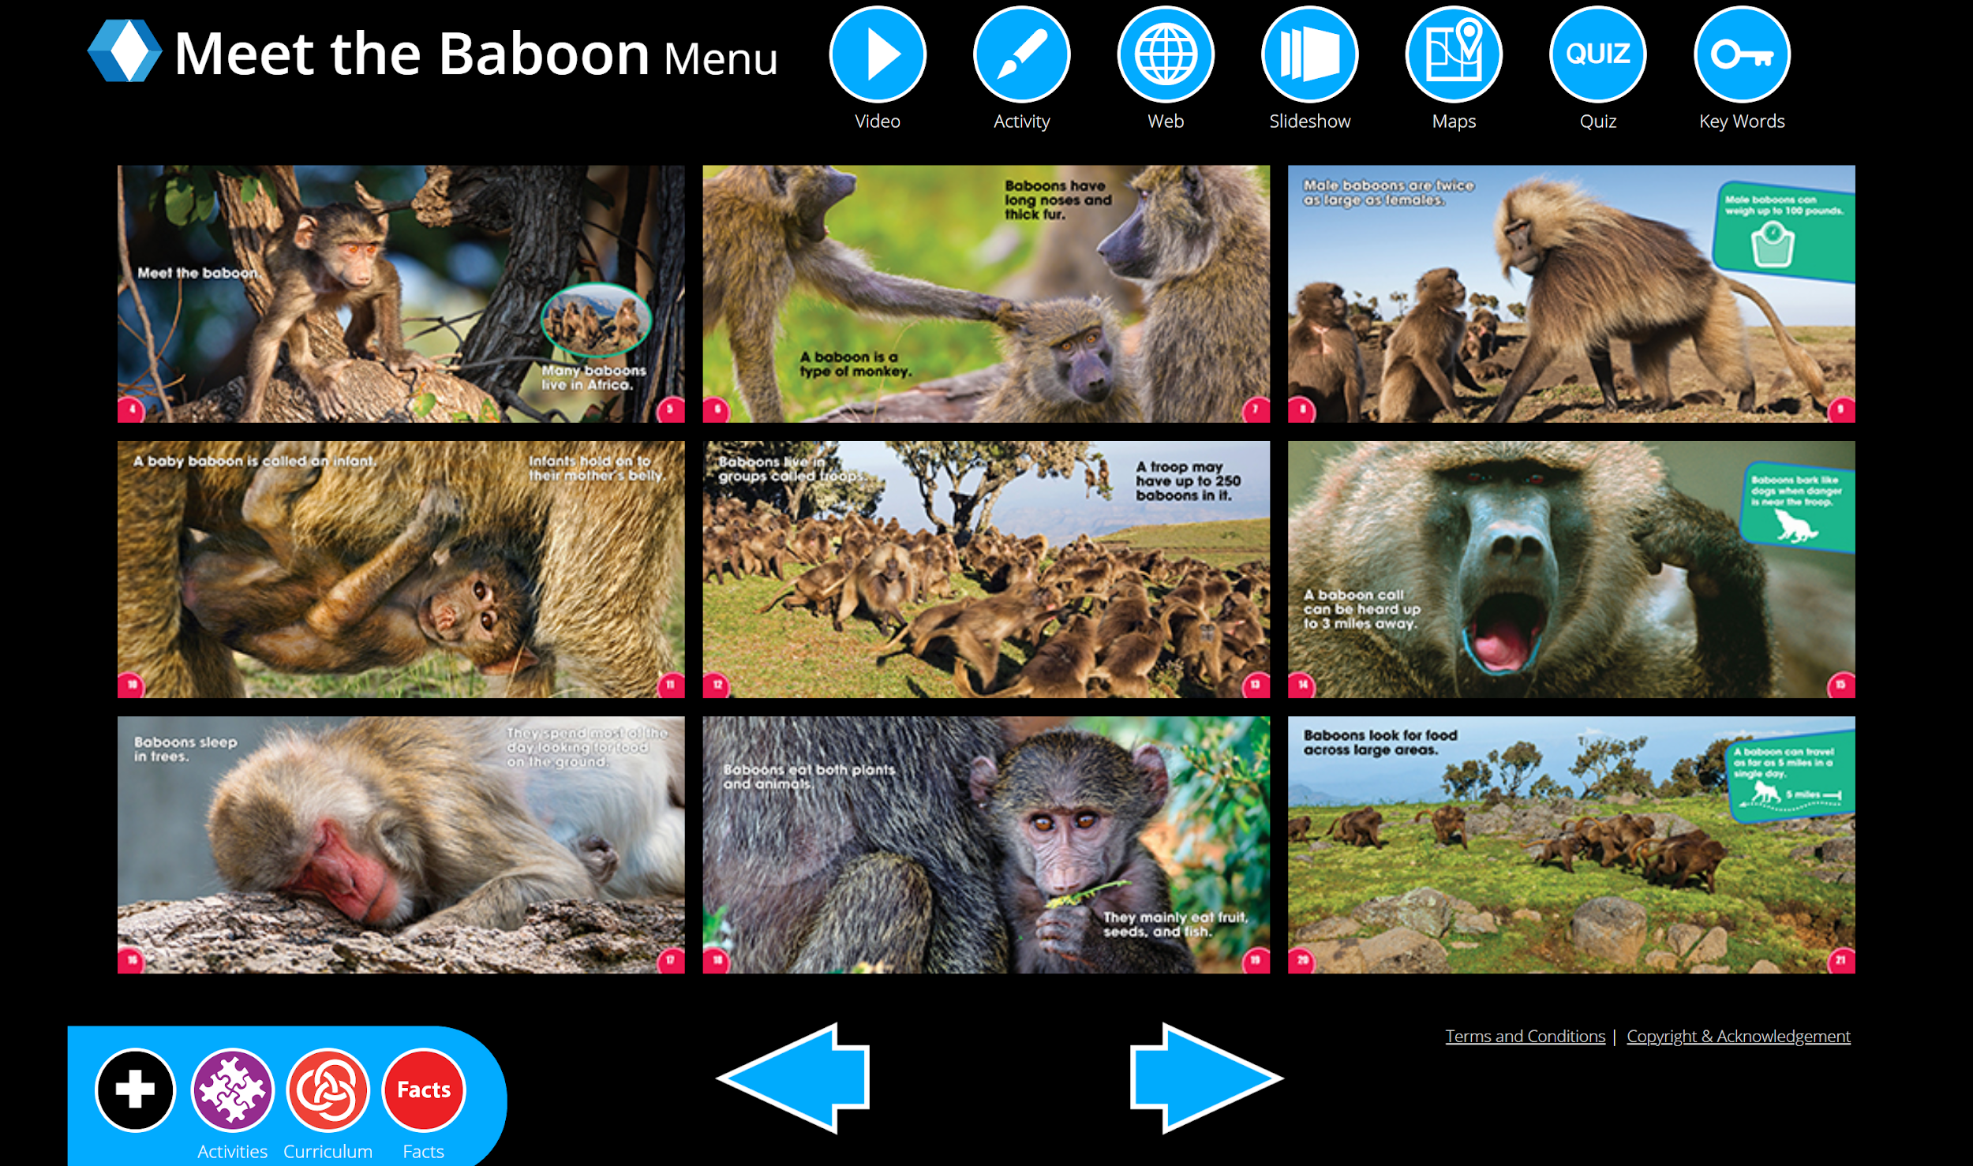
Grades K-2

Slide 28
Grades 6-8

Slide 29
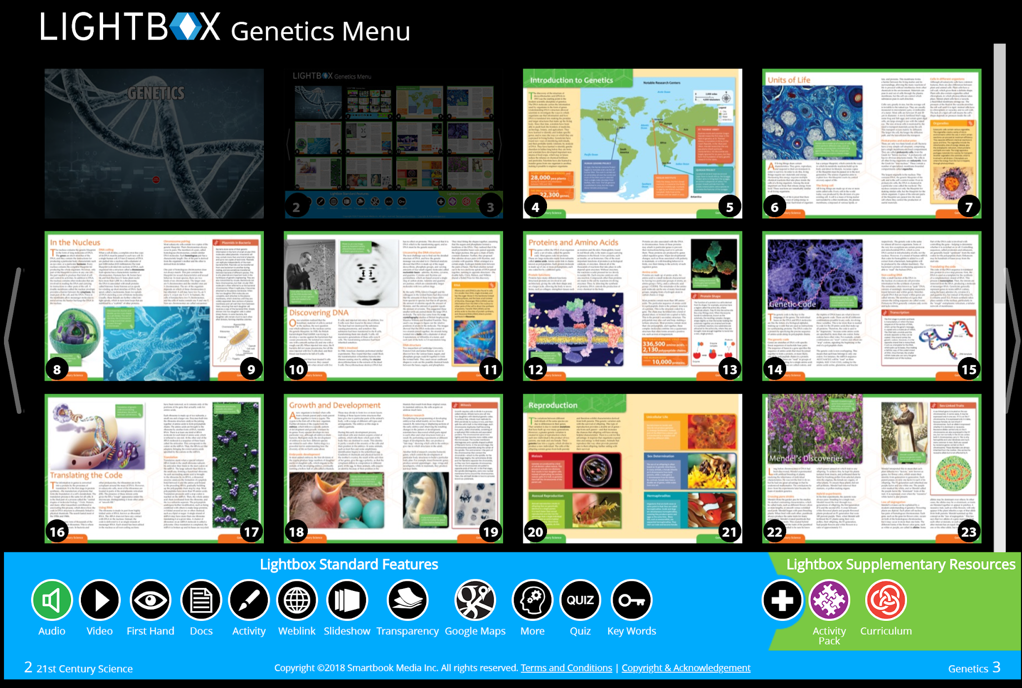
Grades 9-12

Slide 30
ENHANCEMENT
Replace hard copy source materials with digital documents, firsthand accounts, maps, and more. Enable students to complete and submit worksheets, tests, and activities online or by email.
S
Integrate intuitive and dynamic multimedia resources not found in traditional teaching materials. Enhance learning experiences with curriculum-aligned videos, audio, weblinks, and activities. Provide immediate learner feedback using the automatic grading feature, so students know the quality of their learning immediately upon completion.
A
Create presentations, videos, artwork, and other projects using digital Lightbox resources that make it easy to tailor the learning experience to individual interests and needs. Provide varying perspectives and points of view on specific issues or events for a deeper interaction between educators, students, and their peers. Maintain contact with learners even when teaching remotely.
TRANSFORMATION
M
Provide a multi-sensory experience that goes beyond traditional classroom teaching and engages different learning styles while still covering the same core material. Give students the opportunity to accelerate their learning if they are ready for more advanced materials. Explore a variety of subject areas through virtual visits to historic sites, museums, science centers, and other facilities while using the Google Maps feature to gain further insight into specific locations. Provide a launching pad for the creation of multimedia projects, ranging from the creation of videos/short films to multimedia art installations, on a variety of subjects.
R

Slide 32
Laura Sheneman August 17, 2020
Through the Lens of SAMR

